Slide 1
Agile Software Development

Slide 2
Topics covered
Agile methods
Plan-driven and agile development
Extreme programming

Slide 3
Rapid software development
Rapid development and delivery is now often the most important requirement for software systems
  Software has to evolve quickly to reflect changing business needs.
Rapid software development
  Specification, design and implementation are inter-leaved
  System is developed as a series of versions with stakeholders involved in version evaluation
  User interfaces are often developed using an IDE and graphical toolset.

Slide 4
Agile methods
Dissatisfaction with the overheads involved in software design methods of the 1980s and 1990s led to the creation of agile methods. These methods:
  Focus on the code rather than the design
  Are based on an iterative approach to software development
  Are intended to deliver working software quickly and evolve this quickly to meet changing requirements.
The aim of agile methods is to reduce overheads in the software process (e.g. by limiting documentation) and to be able to respond quickly to changing requirements without excessive rework.
Notes:
Trong nhung du an nho, chi phi cua viec len ke hoach, viet tai lieu chiem nhieu
Tai lieu khong phan anh duoc phan mem

Slide 5
Agile methods
Extreme programming
Scrum
Crystal
Adaptive Software Development
DSDM
Feature Drive Development
incremental development
Notes:
Keywork: incremental development

Slide 6
The principles of agile methods
Principle | Description
Customer involvement | Customers should be closely involved throughout the development process. Their role is provide and prioritize new system requirements and to evaluate the iterations of the system.
Incremental delivery | The software is developed in increments with the customer specifying the requirements to be included in each increment.
People not process | The skills of the development team should be recognized and exploited. Team members should be left to develop their own ways of working without prescriptive processes.
Embrace change | Expect the system requirements to change and so design the system to accommodate these changes.
Maintain simplicity | Focus on simplicity in both the software being developed and in the development process. Wherever possible, actively work to eliminate complexity from the system.

Slide 7
Agile method applicability
Product development where a software company is developing a small or medium-sized product for sale.
There is a clear commitment from the customer to become involved in the development process.

Slide 8
Problems with agile methods
It can be difficult to keep the interest of customers who are involved in the process.
Team members may be unsuited to the intense involvement that characterises agile methods.
Prioritising changes can be difficult where there are multiple stakeholders.
Maintaining simplicity requires extra work.
Contracts may be a problem as with other approaches to iterative development.

Slide 9
Agile methods and software maintenance
Most organizations spend more on maintaining existing software than they do on new software development. So, if agile methods are to be successful, they have to support maintenance as well as original development.
Two key issues:
  Are systems that are developed using an agile approach maintainable, given the emphasis in the development process of minimizing formal documentation?
  Can agile methods be used effectively for evolving a system in response to customer change requests?
Problems may arise if original development team cannot be maintained.

Slide 10
Plan-driven and agile development
Plan-driven development
  A plan-driven approach to software engineering is based around separate development stages with the outputs to be produced at each of these stages planned in advance.
  Not necessarily waterfall model – plan-driven, incremental development is possible
  Iteration occurs within activities.
Agile development
  Specification, design, implementation and testing are inter-leaved and the outputs from the development process are decided through a process of negotiation during the software development process.

Slide 11
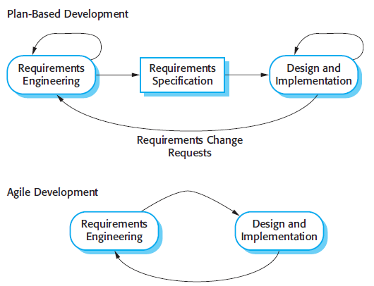
Plan-driven and agile specification

Slide 12
Plan-driven or Agile?
Most projects include elements of plan-driven and agile processes. Deciding on the balance depends on:
Is it important to have a very detailed specification and design before moving to implementation?
If so, you probably need to use a plan-driven approach.
Is an incremental delivery strategy, where you deliver the software to customers and get rapid feedback from them, realistic?
If so, consider using agile methods.
How large is the system that is being developed?
Agile methods are most effective when the system can be developed with a small co-located team who can communicate informally.

Slide 13
Plan-driven or Agile?
What type of system is being developed?
  Plan-driven approaches may be required for systems that require a lot of analysis before implementation (e.g. real-time system with complex timing requirements).
What is the expected system lifetime?
  Long-lifetime systems may require more design documentation to communicate the original intentions of the system developers to the support team.
What technologies are available to support system development?
  Agile methods rely on good tools to keep track of an evolving design

Slide 14
Plan-driven or Agile?
How is the development team organized?
If the development team is distributed or if part of the development is being outsourced, then you may need to develop design documents to communicate across the development teams.
Are there cultural or organizational issues that may affect the system development?
Traditional engineering organizations have a culture of plan-based development, as this is the norm in engineering.
How good are the designers and programmers in the development team?
It is sometimes argued that agile methods require higher skill levels than plan-based approaches in which programmers simply translate a detailed design into code

Slide 15
Extreme programming
Perhaps the best-known and most widely used agile method.
Extreme Programming (XP) takes an ‘extreme’ approach to iterative development.
  New versions may be built several times per day;
  Increments are delivered to customers every 2 weeks;
  All tests must be run for every build and the build is only accepted if tests run successfully.

Slide 16
XP and agile principles
Incremental development is supported through small, frequent system releases.
Customer involvement means full-time customer engagement with the team.
People not process are supported through pair programming, collective ownership and a process that avoids long working hours.
Change supported through regular system releases.
Maintaining simplicity through constant refactoring of code.

Slide 17
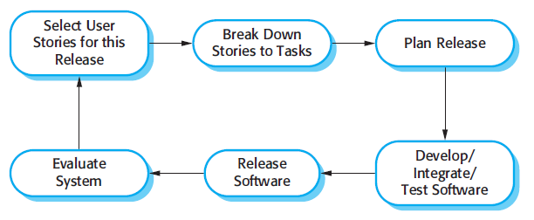
The extreme programming release cycle

Slide 18
Extreme programming practices
Principle or practice | Description
Incremental planning | Requirements are recorded on story cards and the stories to be included in a release are determined by the time available and their relative priority. The developers break these stories into development ‘Tasks’. See Figures 3.5 and 3.6.
Small releases | The minimal useful set of functionality that provides business value is developed first. Releases of the system are frequent and incrementally add functionality to the first release.
Simple design | Enough design is carried out to meet the current requirements and no more.
Test-first development | An automated unit test framework is used to write tests for a new piece of functionality before that functionality itself is implemented.
Refactoring | All developers are expected to refactor the code continuously as soon as possible code improvements are found. This keeps the code simple and maintainable.

Slide 19
Extreme programming practices
Pair programming | Developers work in pairs, checking each other’s work and providing the support to always do a good job.
Collective ownership | The pairs of developers work on all areas of the system, so that no islands of expertise develop and all the developers take responsibility for all of the code. Anyone can change anything.
Continuous integration | As soon as the work on a task is complete, it is integrated into the whole system. After any such integration, all the unit tests in the system must pass.
Sustainable pace | Large amounts of overtime are not considered acceptable as the net effect is often to reduce code quality and medium term productivity
On-site customer | A representative of the end-user of the system (the customer) should be available full time for the use of the XP team. In an extreme programming process, the customer is a member of the development team and is responsible for bringing system requirements to the team for implementation.

Slide 20
Requirements scenarios
In XP, a customer or user is part of the XP team and is responsible for making decisions on requirements.
User requirements are expressed as scenarios or user stories.
These are written on cards (story card) and the development team break them down into implementation tasks. These tasks are the basis of schedule and cost estimates.
The customer chooses the stories for inclusion in the next release based on their priorities and the schedule estimates.

Slide 21
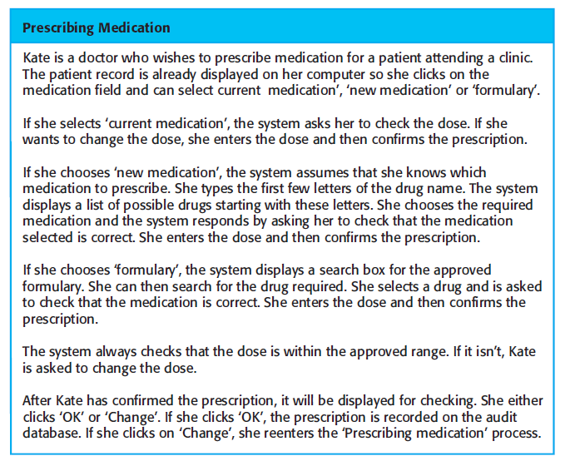
A ‘prescribing medication’ story

Slide 22
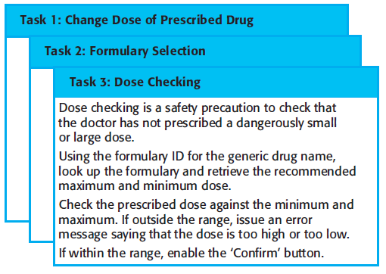
Examples of task cards

Slide 23
XP and change
Conventional wisdom in software engineering is to design for change. It is worth spending time and effort anticipating changes as this reduces costs later in the life cycle.
XP, however, maintains that this is not worthwhile as changes cannot be reliably anticipated.
Rather, it proposes constant code improvement (refactoring) to make changes easier when they have to be implemented.

Slide 24
Refactoring
Programming team look for possible software improvements and make these improvements even where there is no immediate need for them.
This improves the understandability of the software and so reduces the need for documentation.
Changes are easier to make because the code is well-structured and clear.
However, some changes requires architecture refactoring and this is much more expensive.

Slide 25
Examples of refactoring
Re-organization of a class hierarchy to remove duplicate code.
Tidying up and renaming attributes and methods to make them easier to understand.
The replacement of inline code with calls to methods that have been included in a program library.

Slide 26
Key points
Agile methods are incremental development methods that focus on rapid development, frequent releases of the software, reducing process overheads and producing high-quality code.
Agile methods involve the customer directly in the development process.
The decision on whether to use an agile or a plan-driven approach to development should depend on the type of software being developed, the capabilities of the development team and the culture of the company developing the system.
Extreme programming is a well-known agile method

Slide 27
Testing in XP
Testing is central to XP and XP has developed an approach where the program is tested after every change has been made.
XP testing features:
  Test-first development.
  Incremental test development from scenarios.
  User involvement in test development and validation.
  Automated test harnesses are used to run all component tests each time that a new release is built.

Slide 28
Test-first development
Writing tests before code clarifies the requirements to be implemented.
Tests are written as programs rather than data so that they can be executed automatically. The test includes a check that it has executed correctly.
  Usually relies on a testing framework such as Junit.
All previous and new tests are run automatically when new functionality is added, thus checking that the new functionality has not introduced errors.

Slide 29


Slide 30
Bài tập
Nộp báo cáo: 31/12/2013
Số trang: <=20
Nộp bản mềm qua email hieuvd@vnu.edu.vn với tiêu đề “[ASE] Bài tập – Nhóm 1”. Tên file báo cáo là Nhom1.doc, Nhom1.docx, hoặc Nhom1.zip

